Slide 1
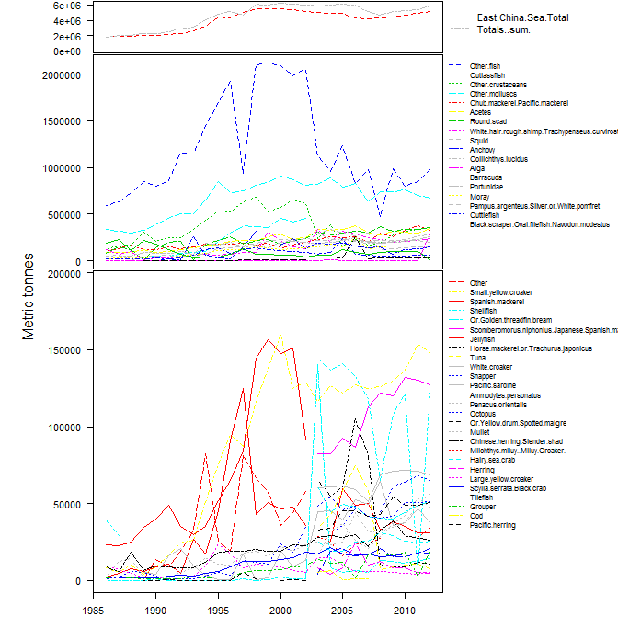

Slide 2
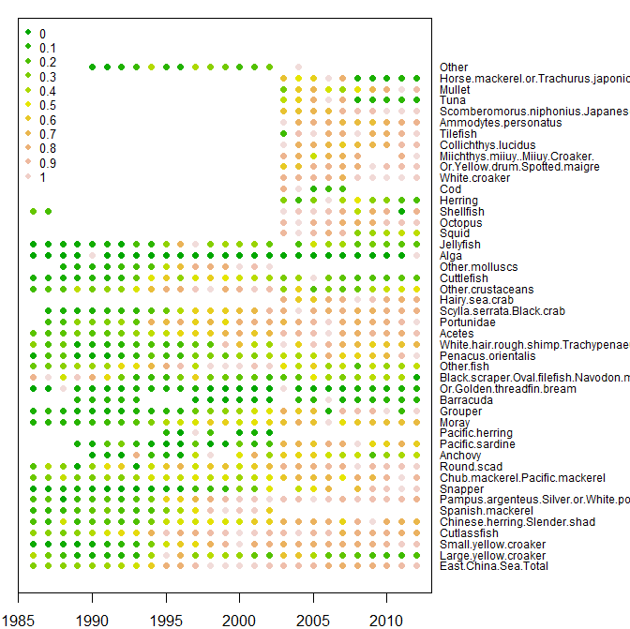

Slide 3
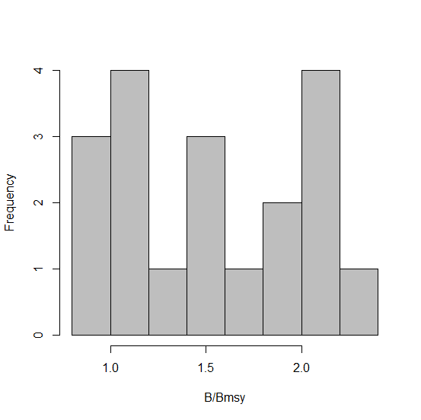

Slide 4
 | Mod1 | Mod2 | Mod3 | Mod4 | Mod5 | Mod6
Inverse age | -0.057 | -0.037 | 0.055 | 0.041 | 0.049 | 0.018
Scaled catch 4 years ago | -0.139 | -0.13 | -0.056 | -0.096 | -0.101 | -0.118
Scaled catch 3 years ago | -0.055 | -0.057 | 0.006 | -0.004 | -0.003 | -0.02
Scaled catch 2 years ago | 0.034 | 0.044 | 0.153 | 0.136 | 0.136 | 0.136
Scaled catch 1 years ago | 0.253 | 0.287 | 0.426 | 0.416 | 0.426 | 0.437
Scaled catch current | 0.255 | 0.137 | -0.474 | -0.372 | -0.393 | -0.475
Years to max catch | 0.011 | 0.011 | 0.007 | 0.008 | 0.007 | 0.005
Initial slope of catch | -0.039 | 0.021 | 0.128 | 0.108 | 0.106 | 0.171
maximum catch | 0 | 0 | 0 | 0 | 0 | 0
mean scaled catch | 0.978 | 0.763 | -0.473 | -0.263 | -0.357 | -0.24
Von Bert K | 0.378 | 0.818 | 1.292 | 0.984
Temperature | 0.002
Geographic distribution | 0 | 0 | 0
Max length | -0.003 | -0.003 | -0.003 | -0.003 | -0.003
Age at maturity | -0.025 | -0.003
Running harvest ratio | 0.705 | 0.794 | 1.231 | 1.165 | 1.184 | 1.167
Current year | -0.062 | -0.041 | 0.056 | 0.039 | 0.047 | 0.016
Cods | 0.242 | 0.297 | 0.331 | 0.39 | 0.379 | 0.1
Misc. coastal fish | 0.124 | 0.153 | -0.951 | -0.71 | -0.618 | -0.476
Misc. demersal fish | 1.015 | 0.932 | 0.815 | 0.796 | 0.755 | 0.671
Herrings sardines anchovies | -0.106 | -0.075 | -0.238 | -0.102 | 0.058 | 0.093
Tuna bonito billfish | 0.314 | 0.641 | 0.818 | 0.785 | 0.943 | 0.255
Misc pelagic fish | -0.003 | 0.395 | 0.288 | 0.437 | 0.492 | 0.402
Constant | 123.799 | 80.707 | -112.955 | -78.581 | -95.563 | -32.489

Slide 5
Regression interpretation (model 6)
↑ Catch[t-1]
↑status
↑ Catch[t]/max(Catch[1:(t-1)])
↑ status
Demersal fish
↑ status.

Slide 6

Simulate known populations
$$B_{t+1}=B_{t}+{rB}_{t}\left(1−\frac{B_{t}}{K}\right)−C_{t}$$
$$C_{t+1}=\frac{C_{t}}{B_{t}} {(\frac{B_{t}}{\frac{aB_{0}}{2}})}^{x}B_{t+1}$$
Notes:
The logical rebuttle to the reason the methods aren’t able to predict the statuses is that the RAM stocks don’t behave like the simulated population. However, the validity of the concept of MSY requires that these models are correct.

Slide 7
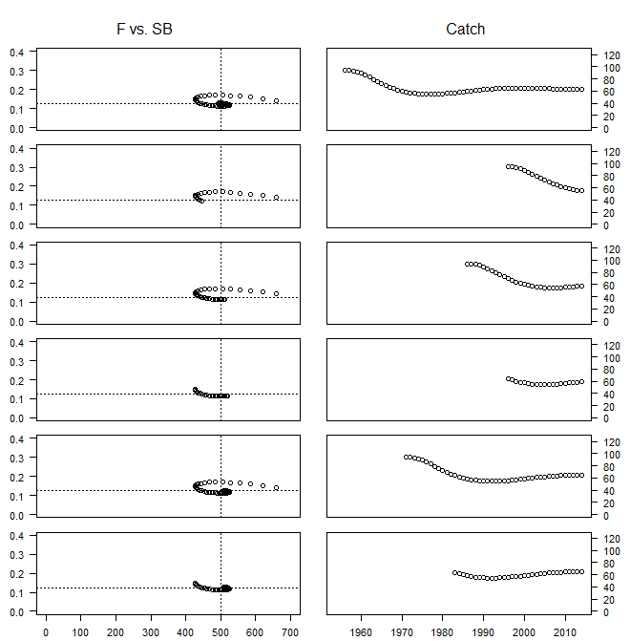
Estimated status | True status
1.37 | .98
1.23 | .89
1.29 | 1.02
1.75 | 1.03
1.41 | 1.01
2.22 | 1.01

Slide 8

Estimated status | True status
1.01 | .98
.91 | .89
.95 | 1.02
1.29 | 1.03
1.04 | 1.01
1.63 | 1.01

Slide 9
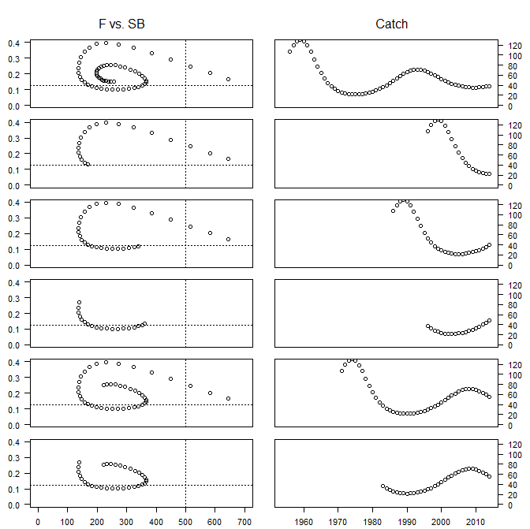
Estimated status | True status
.98 | .51
.83 | .34
.99 | .68
2.45 | .72
1.15 | .44
1.83 | .44

Slide 10

Estimated status | True status
.73 | .51
.61 | .34
.73 | .68
1.81 | .72
.85 | .44
1.35 | .44

Slide 11
Challenges of catch-based methods
Technical efficiency
Trophic interactions
Environment – MSwhy are we still using this??? (c)
RAMiness
Time series similarity between the fisheries

